Slide 1


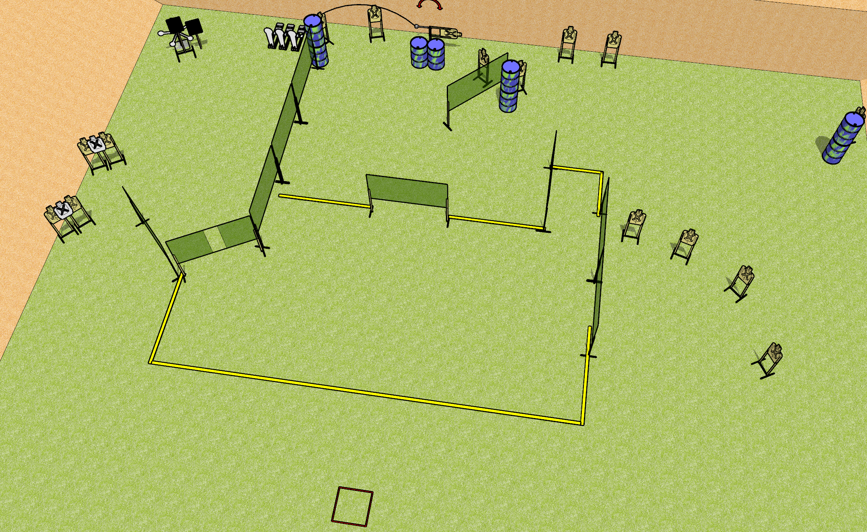
 | Dothan Gun Club – USPSA Match Remember, no REF’s Course Designer : Drew Coleman
START POSITION : Standing in start box
GUN READY CONDITION : Pistol loaded and holstered. PCC pointed in a safe direction |  | SCORING: Comstock, 40 rounds TARGETS: 16 paper, 8 Steel SCORED HITS: Best 2 on paper, steel until down START-STOP: Audible, last shot RULES: Start box is NOT part of the shooting area
STAGE PROCEDURE: Engage targets as they become available from within the fault lines

